Slide 1
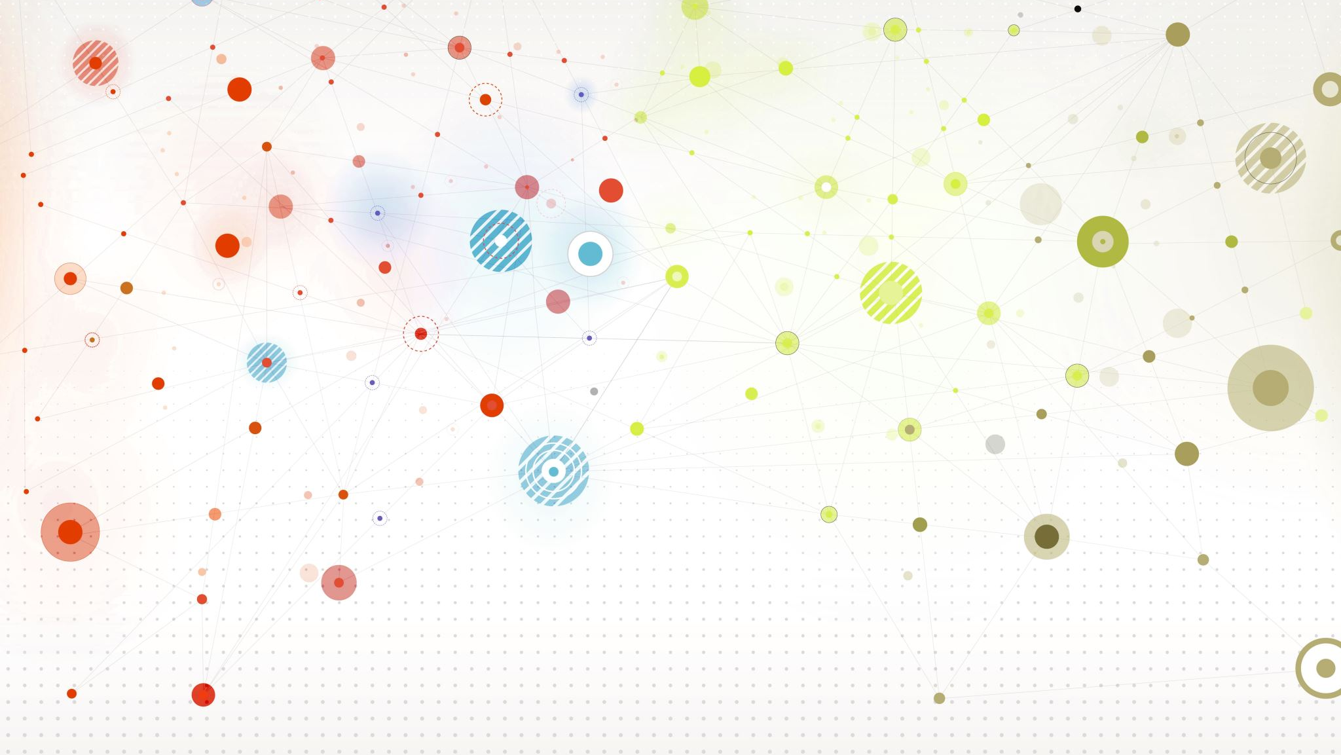
Convolutional Neural Networks (CNN)
This lecture corresponding to textbook section 10.3
Intro to Statistical and Machine Learning
Duo Yu
November 9, 2023

Slide 2
Outline
Basic idea of CNN
State-of-the-art CNN model, deep residual neural networks (ResNets)
Application to MNIST and CIFAR-10, Python illustration

Slide 3
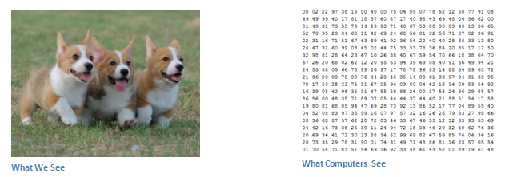
Data:
When a computer sees an image (takes an image as input), it will see an array of pixel values. Depending on the resolution and size of the image, it will see a 32 x 32 x 3 array of numbers (The 3 refers to RGB values). Just to drive home the point, let's say we have a color image in JPG form and its size is 480 x 480. The representative array will be 480 x 480 x 3. Each of these numbers is given a value from 0 to 255 which describes the pixel intensity at that point. These numbers, while meaningless to us when we perform image classification, are the only inputs available to the computer. The idea is that you give the computer this array of numbers and it will output numbers that describe the probability of the image being a certain class (.80 for cat, .15 for dog, .05 for bird, etc).

Slide 4
Convolutional Neural Networks (CNN)
CNNs has shown spectacular success on the wide range of image recognition problems.
CNNs contains a combination of two types of hidden layers, called convolution layers and pooling layers.
The convolution layers are used to account for the correlation between neighboring inputs.
The pooling layers are used to reduce the dimension such that the output is robust against location shifts in inputs.

Slide 5
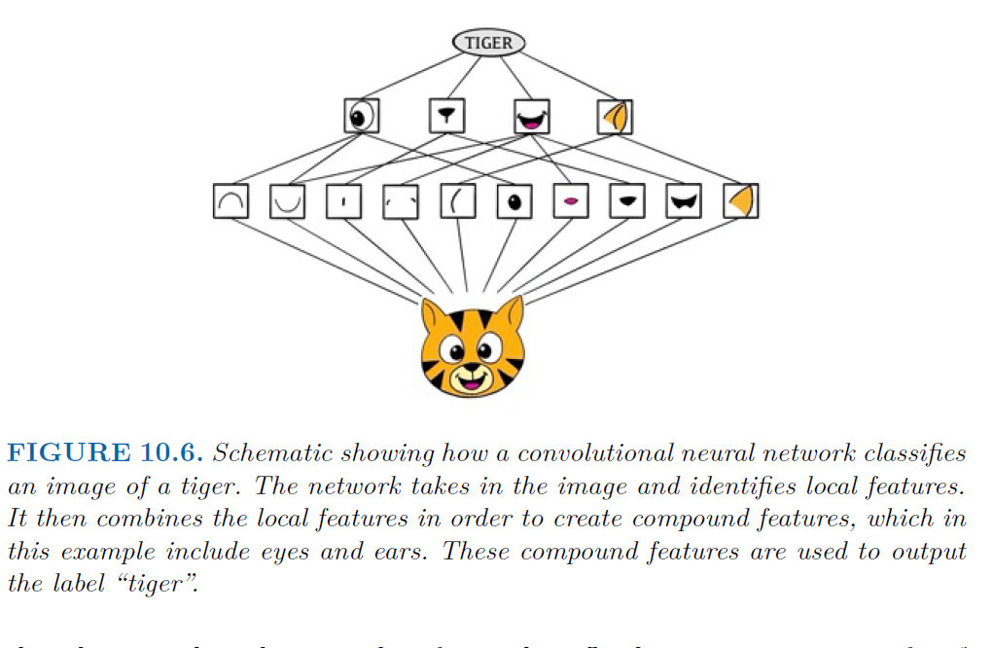
Convolutional Neural Networks (CNN)
Image processing:
Identify low-level features in the input image
Combine low-level features to form high-level features
The presence or absence of these higher-level features determine the probability of any given output class

Slide 6
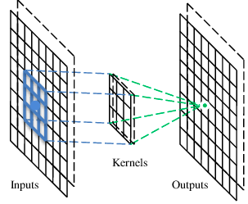
Convolution layer
Convolution is a filter that extracts features and removes noises from the data.
Convolve the filter with the image, i.e. “slide over the image spatially computing dot products”
A filter

Slide 7
Convolution
These are the network parameters to be learned.
1 | -1 | -1
-1 | 1 | -1
-1 | -1 | 1
1 | 0 | 0 | 0 | 0 | 1
0 | 1 | 0 | 0 | 1 | 0
0 | 0 | 1 | 1 | 0 | 0
1 | 0 | 0 | 0 | 1 | 0
0 | 1 | 0 | 0 | 1 | 0
0 | 0 | 1 | 0 | 1 | 0
Filter 1
-1 | 1 | -1
-1 | 1 | -1
-1 | 1 | -1
Filter 2
……
6 x 6 image
Each filter detects a small pattern (3 x 3).

Slide 8
Convolution
1 | -1 | -1
-1 | 1 | -1
-1 | -1 | 1
Filter 1
stride=1
1 | 0 | 0 | 0 | 0 | 1
0 | 1 | 0 | 0 | 1 | 0
0 | 0 | 1 | 1 | 0 | 0
1 | 0 | 0 | 0 | 1 | 0
0 | 1 | 0 | 0 | 1 | 0
0 | 0 | 1 | 0 | 1 | 0
Dot
product
3
-1
6 x 6 image

Slide 9
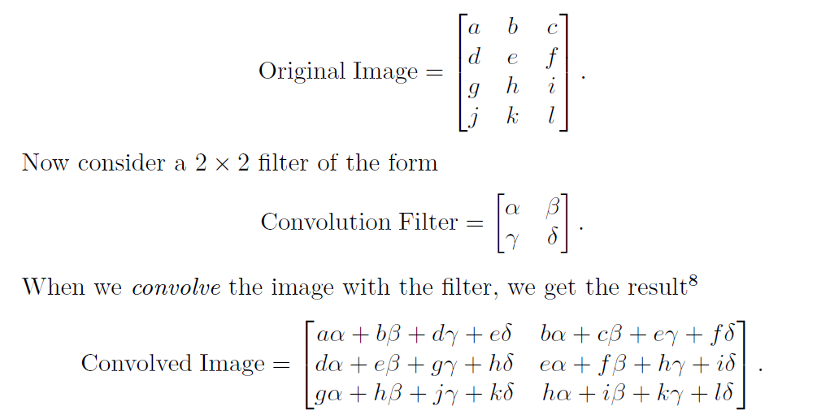
Convolution layer with stride=1

Slide 10
Convolution
1 | -1 | -1
-1 | 1 | -1
-1 | -1 | 1
Filter 1
stride=2
1 | 0 | 0 | 0 | 0 | 1
0 | 1 | 0 | 0 | 1 | 0
0 | 0 | 1 | 1 | 0 | 0
1 | 0 | 0 | 0 | 1 | 0
0 | 1 | 0 | 0 | 1 | 0
0 | 0 | 1 | 0 | 1 | 0
3
-3
6 x 6 image

Slide 11

.
Stride is defined as the number of pixels with which we slide the filter over the input image
1
0
-1
Filter
Feature Map
-2
2
-2
2
Weight sharing:
Same weights used for all possible patches in the image.
-1
1
0
0
3
2
1
1
2
3
0
zero padding
The size of the convolutional layer in one dimension:
the stride (S)
Size of input
the size (F) of the filter

Slide 12
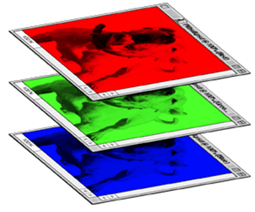
Color image: RGB 3 channels
1 | -1 | -1
-1 | 1 | -1
-1 | -1 | 1
-1 | 1 | -1
-1 | 1 | -1
-1 | 1 | -1
1 | -1 | -1
-1 | 1 | -1
-1 | -1 | 1
-1 | 1 | -1
-1 | 1 | -1
-1 | 1 | -1
1 | -1 | -1
-1 | 1 | -1
-1 | -1 | 1
-1 | 1 | -1
-1 | 1 | -1
-1 | 1 | -1
Filter 1
Filter 2
Color image
1 | 0 | 0 | 0 | 0 | 1
0 | 1 | 0 | 0 | 1 | 0
0 | 0 | 1 | 1 | 0 | 0
1 | 0 | 0 | 0 | 1 | 0
0 | 1 | 0 | 0 | 1 | 0
0 | 0 | 1 | 0 | 1 | 0
1 | 0 | 0 | 0 | 0 | 1
0 | 1 | 0 | 0 | 1 | 0
0 | 0 | 1 | 1 | 0 | 0
1 | 0 | 0 | 0 | 1 | 0
0 | 1 | 0 | 0 | 1 | 0
0 | 0 | 1 | 0 | 1 | 0
1 | 0 | 0 | 0 | 0 | 1
0 | 1 | 0 | 0 | 1 | 0
0 | 0 | 1 | 1 | 0 | 0
1 | 0 | 0 | 0 | 1 | 0
0 | 1 | 0 | 0 | 1 | 0
0 | 0 | 1 | 0 | 1 | 0

Slide 13
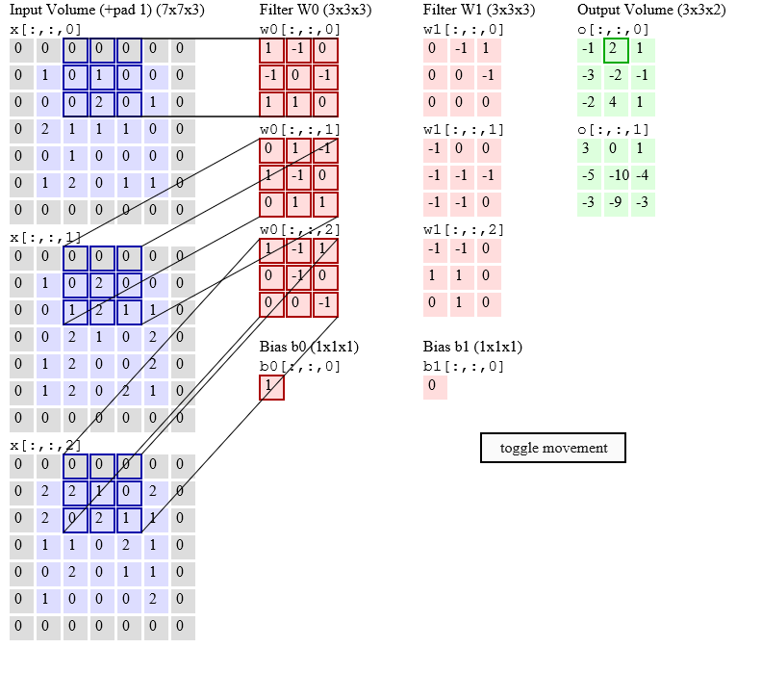

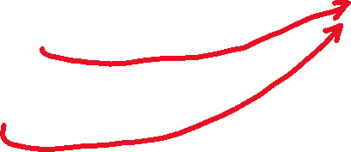
RGB Example
Stride: 2
(2)*(1)+
(-2)+2*1+1*1+
(1)*(-1)+(1)*(-1)+
1
=2-2+2+1-1-1+1=2

Slide 14
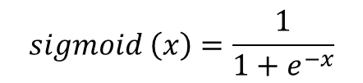
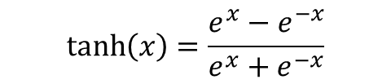
Nonlinear Layer (Activation)
$$\tanh\left(x\right)=\frac{e^{x}−e^{−x}}{e^{x}+e^{−x}}$$
Pooling layer
$$sigmoid \left(x\right)=\frac{1}{1+e^{−x}}$$
Detector layer
Convolution layer

Slide 15
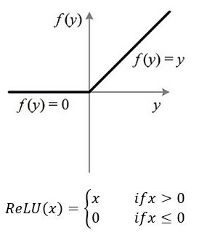
The ReLU function: Rectified Linear Unit

Slide 16
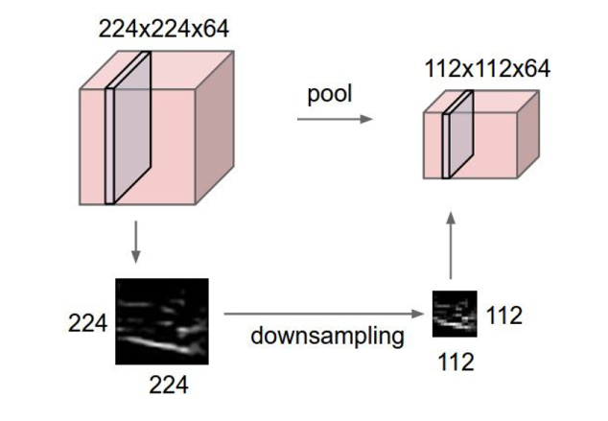
Pooling layer
Make the activation map smaller and more manageable
Operates over each activation map independently

Slide 17
Max pooling
3×3 block
5 | 3 | 2 | 1 | 1 | 7
4 | 2 | 1 | 5 | 1 | 4
2 | 4 | 3 | 2 | 3 | 5
1 | 3 | 5 | 8 | 4 | 2
6 | 2 | 3 | 2 | 1 | 5
3 | 4 | 2 | 3 | 5 | 3
Output matrix
5 | 7
6 | 8
Max pooling
Stride S=3

Slide 18
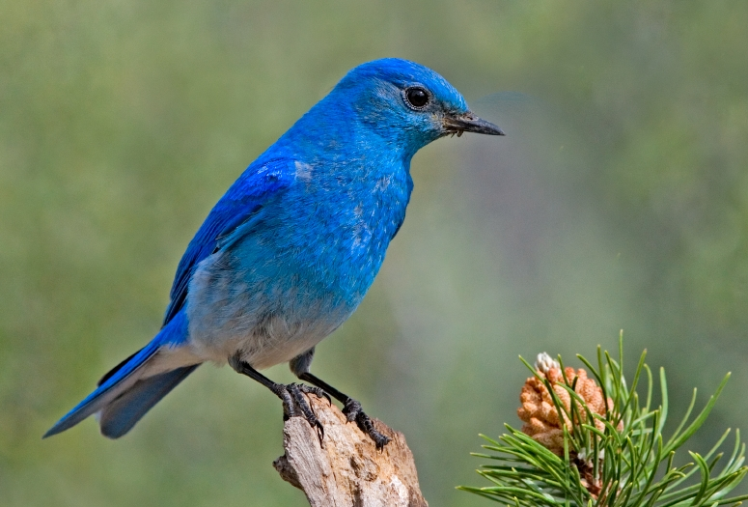

Why Pooling
Subsampling pixels will not change the object
bird
bird
Subsampling
We can subsample the pixels to make image smaller
fewer parameters to characterize the image

Slide 19
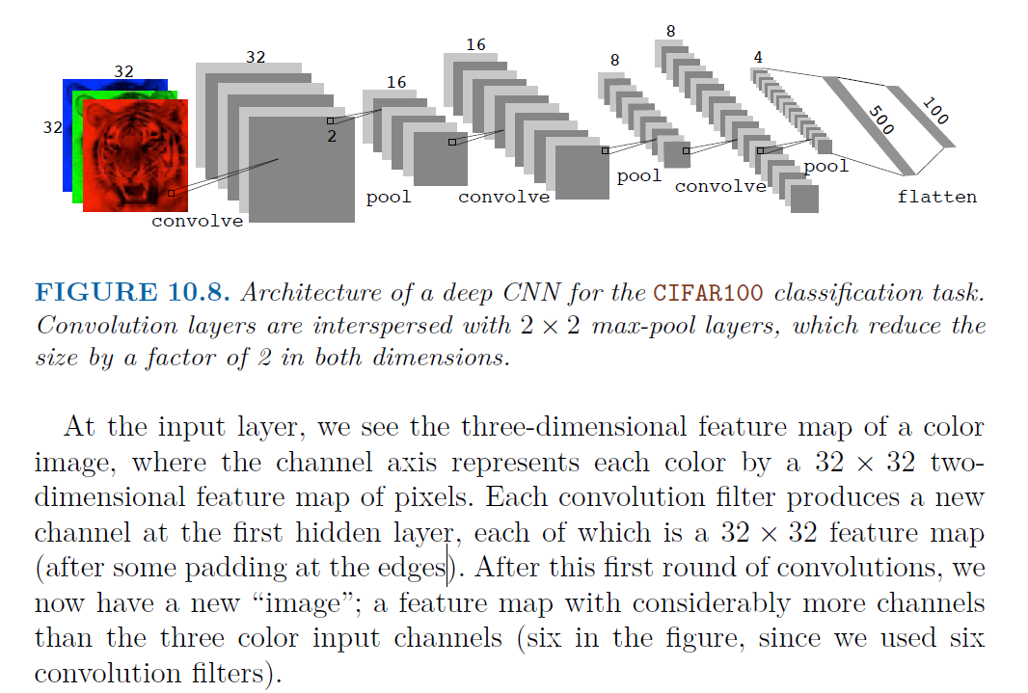
The whole CNN architecture

Slide 20
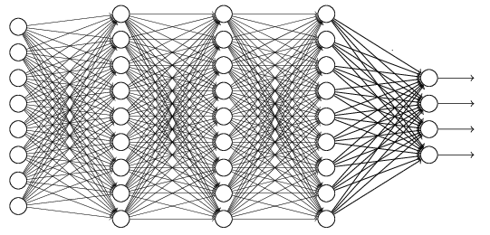
Flattening
3
0
1
3
0
-1
1
3
3
1
-1
0
3
Flattened
1
Fully Connected Feedforward network
0
3

Slide 21
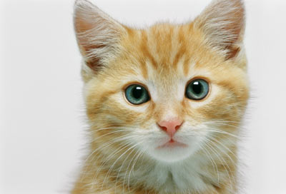
The whole CNN
cat dog ……
Convolution
Max Pooling
Fully Connected Feedforward network
A new image
Convolution
Max Pooling
Flattened
A new image

